Slide 1

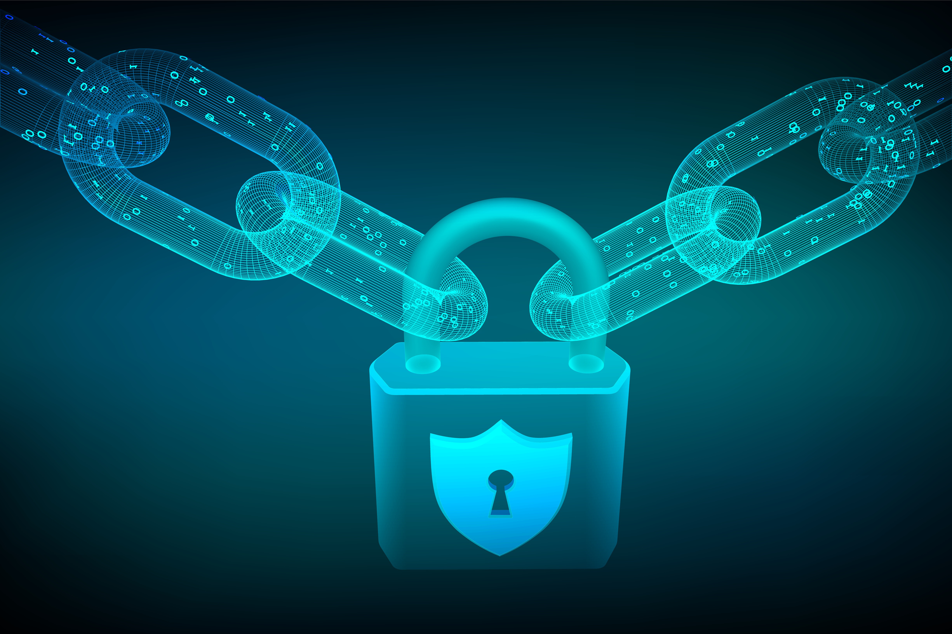

ENHANCING ACADEMIC CERTIFICATE INTEGRITY WITH BLOCKCHAIN TECHNOLOGY
Presented by: Mohammad Avez Khatri

Slide 2





THE CHALLENGE
Traditional verification methods are inefficient and vulnerable to fraud. Certificates can be easily tampered with, and the verification process is often slow, causing unnecessary delays.
01
Traditional methods are outdated
Paper-based verification systems are inefficient and struggle to keep pace with modern demands.
02
High risk of fraud
Certificates can be easily forged, and centralized databases are vulnerable to cyberattacks.
03
Easily tampered with
Traditional certificates and documents can be altered, compromising trust in their authenticity.
04
Slow verification process
Manual verification of credentials is time-consuming, delaying decision-making for institutions and employers.

Slide 3

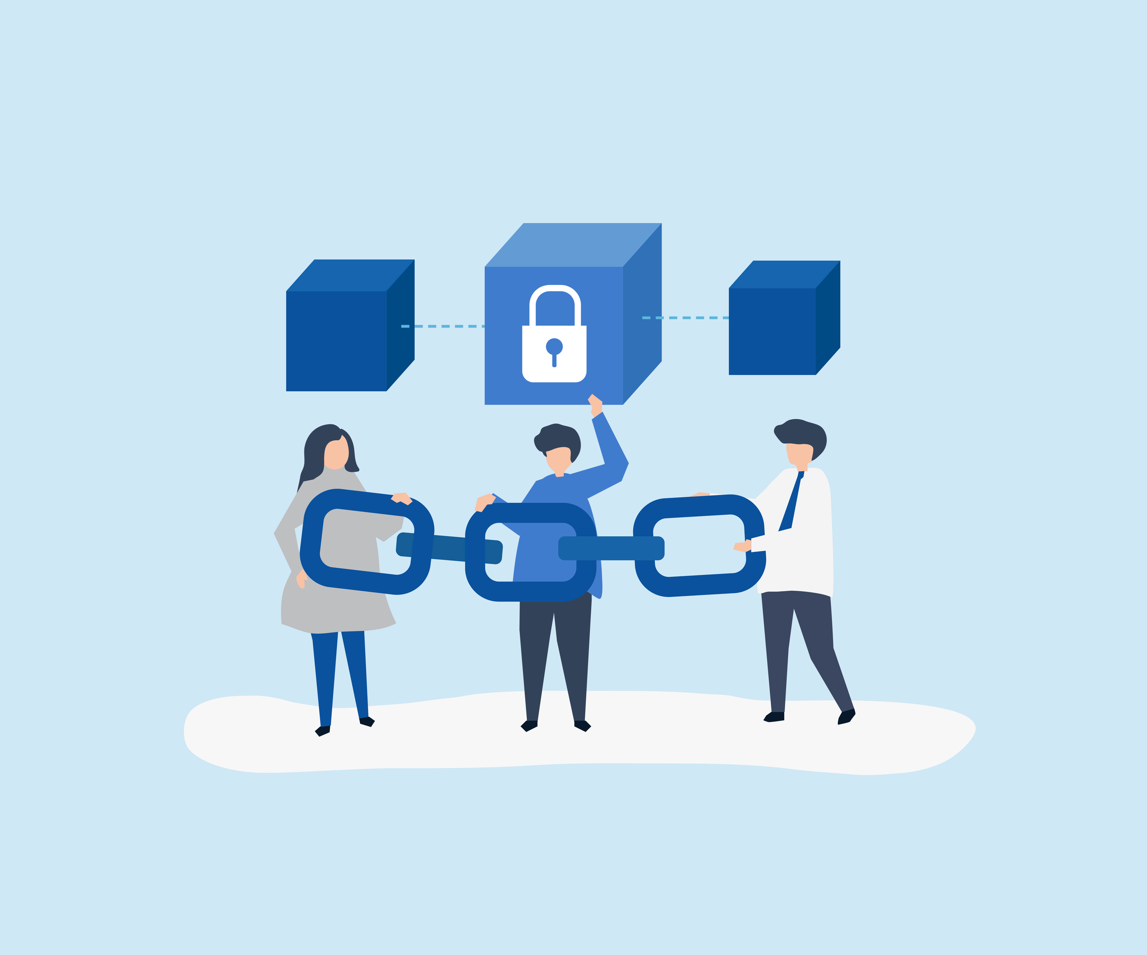
BLOCKCHAIN SOLUTION
Built on Ethereum blockchain: The system leverages the Ethereum blockchain to store credentials in an immutable and decentralized manner.
Immutable and tamper-proof: Once certificates are stored on the blockchain, they cannot be altered or deleted, ensuring long-term data integrity.
Instantaneous verification: Credentials can be verified instantly from anywhere, eliminating the need for third-party verification services.
Enhanced trust and security: Full encryption on the blockchain ensures privacy and security for all stored certificates.

Slide 4
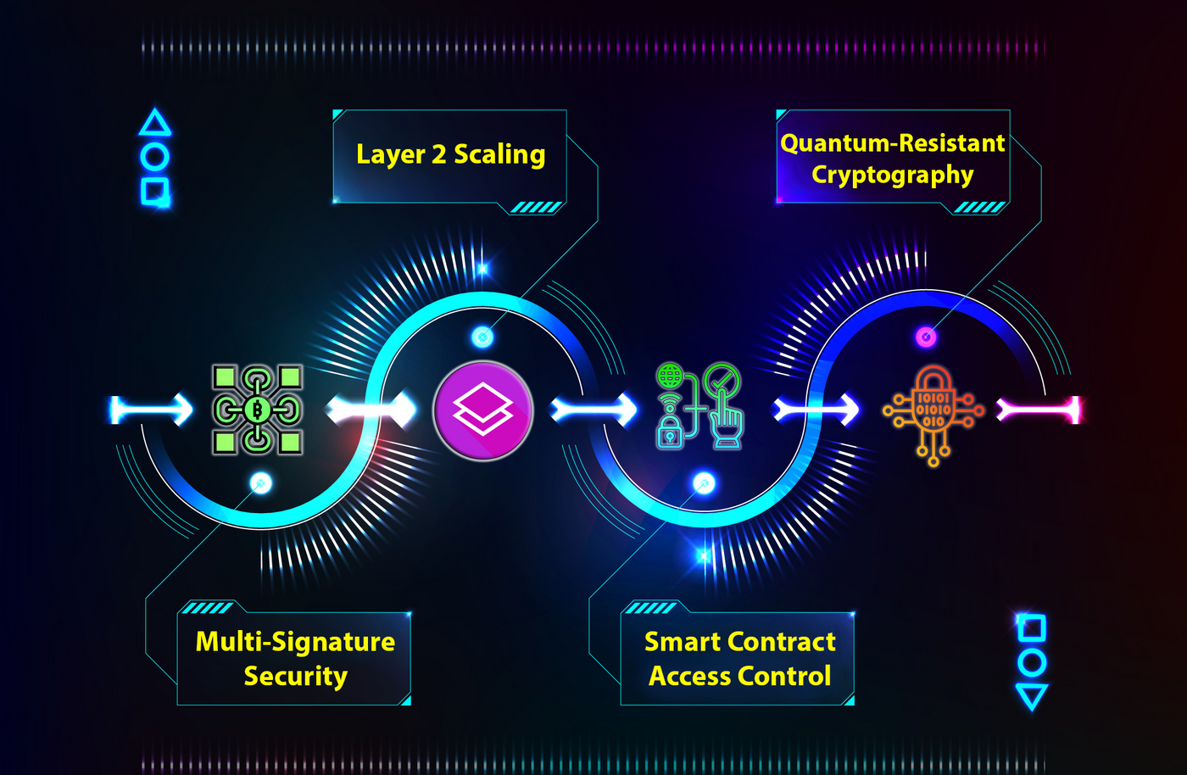


PROPOSED ENHANCEMENTS
Our system leads the way, with plans to introduce features that further enhance security, scalability, and privacy:

Slide 5
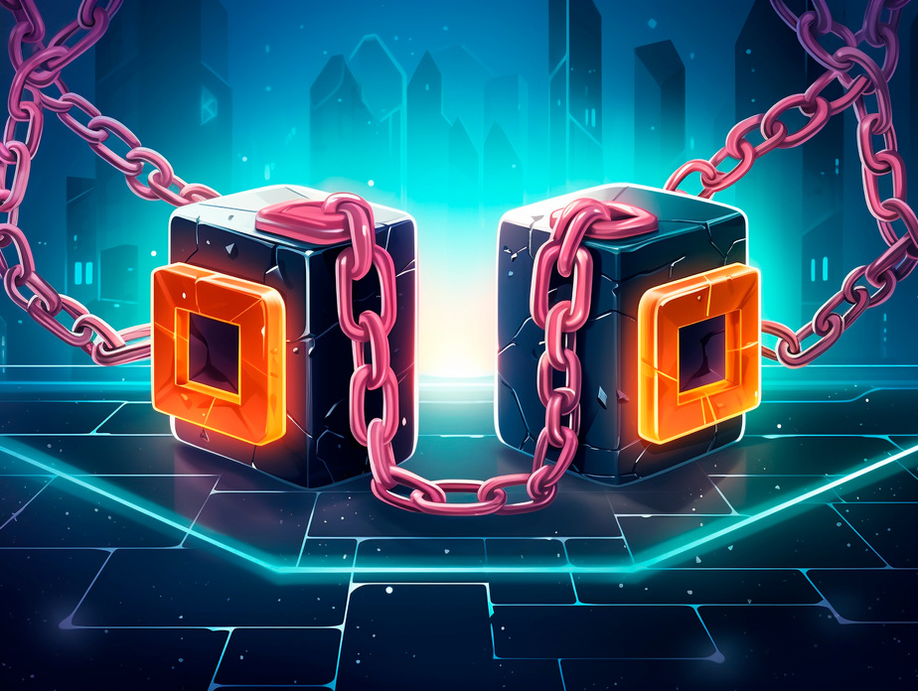

MULTI-SIGNATURE AND LAYER 2 SCALING
Multi-Signature Security
Multi-signature ensures that critical actions, such as certificate issuance and revocation, require approvals from multiple authorized parties. This prevents unauthorized changes and strengthens system security.
Layer 2 Scaling for Efficiency
To address high gas costs and improve transaction speed, we will implement Layer 2 scaling solutions. This will make the system more affordable and scalable for widespread use without compromising performance.

Slide 6

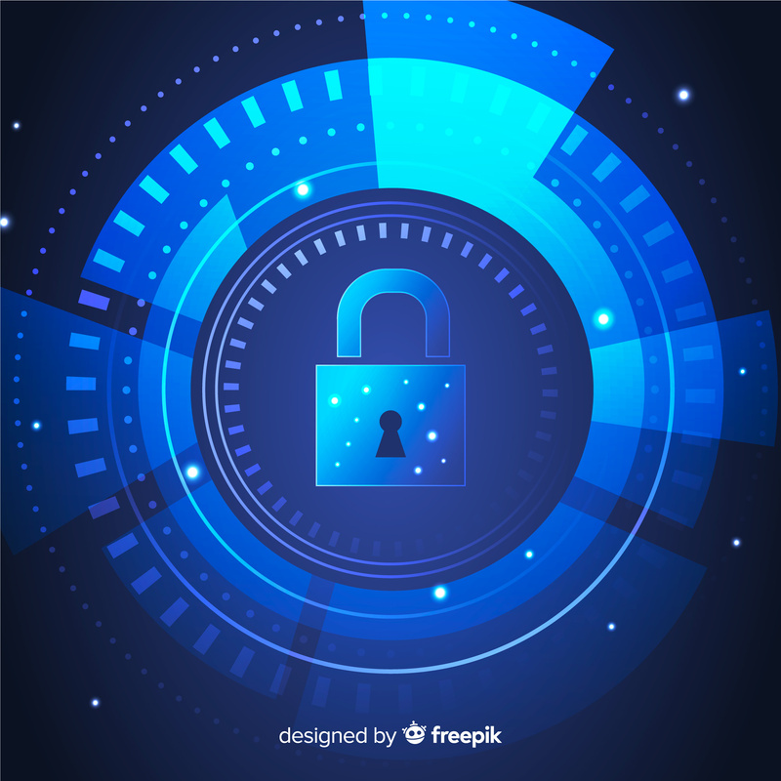
QUANTUM RESISTANCE AND SMART CONTRACT ACCESS CONTROL
Quantum-Resistant Cryptography
As quantum computing advances, traditional cryptography will become vulnerable. We are preparing by developing quantum-resistant cryptographic methods, such as lattice-based algorithms, to ensure that certificates remain secure in the future.
Smart Contract Access Control
Our smart contracts are equipped with strict access control, allowing only authorized users to manage and interact with certificates. This ensures that no unauthorized party can make changes, adding an extra layer of protection.

Slide 7

FUTURE APPLICATIONS
Healthcare Records
Secure, tamper-proof storage of medical records, ensuring privacy and real-time access for patients and providers.
Blockchain secures legal contracts, making them transparent, tamper-proof, and easily verifiable in sectors like law, real estate, and finance.
Legal Document Verification:
Business Contract Management
Transparent contract management with an auditable trail, preventing disputes over altered agreements.
Secure issuance of licenses, permits, and public records, ensuring document integrity and trust for citizens and businesses.
Government Issuances

Slide 8

CONCLUSION
💡
📝
🚀
Revolutionizing Credential Management
Key Features Recap
Future Ready
Roadmap
Through multi-signature security, Layer 2 scaling, quantum-resistant cryptography, and robust access control, we ensure the highest level of privacy and security.
By preparing for quantum computing and expanding to industries like healthcare, legal, and government, our system is built to solve today’s challenges and tomorrow’s threats.
Our blockchain-based system provides a secure, scalable, and future-proof solution for managing credentials.

Slide 9


Thank's For Watching
I am seeking opportunities in cybersecurity and blockchain.
For any leads, please reach out at:
theavezkhatri@hotmail.com

